Slide 1
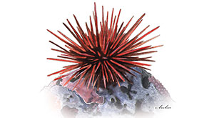
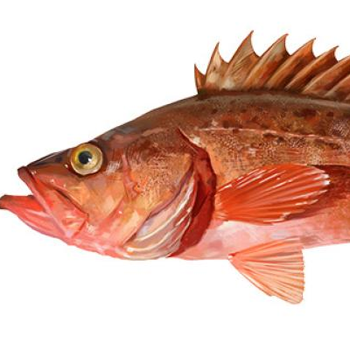
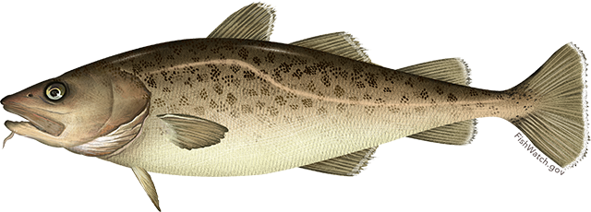
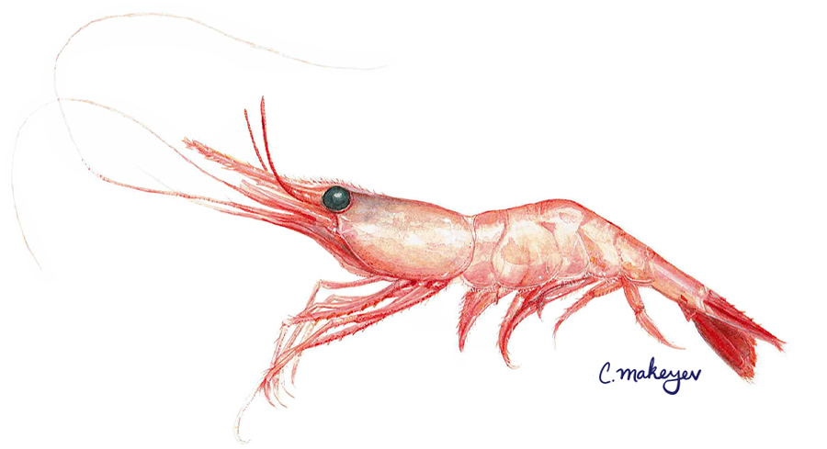
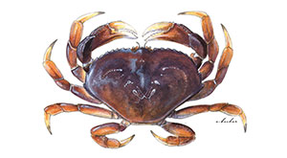
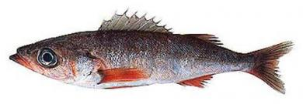
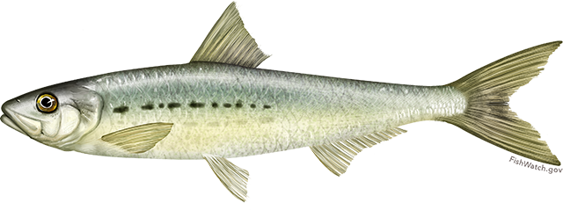
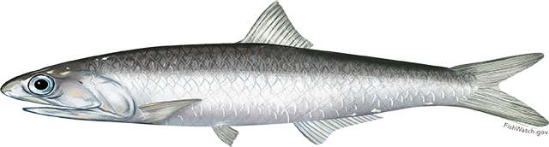
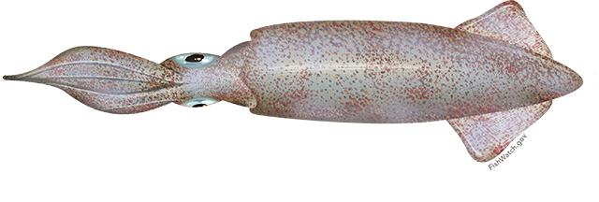
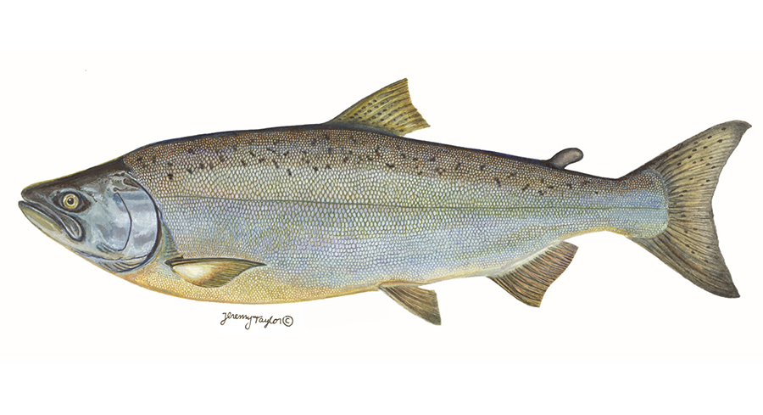
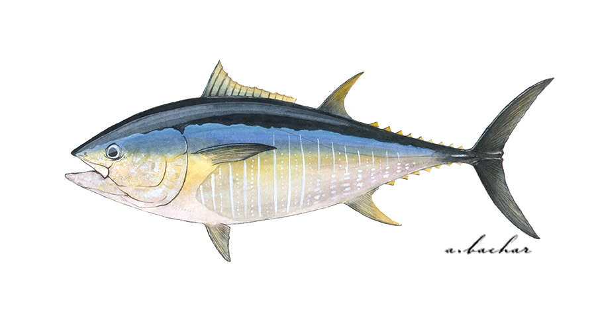
Urchin/abalone
Population declines due to loss of kelp beds.
Bocaccio
Enormously high recruitment rebuilds threatened fish stock.
Pacific cod
Population declines due to reduced prey and increased metabolic demands.
Shrimp
Major heatwave and climate change winner – but don’t know why yet
Dungeness crab
Fishery closures due HABs and whale entanglements.
Shortbelly rockfish
Increases in abundance approached bycatch limits in Pacific hake fishery.
Sardine/anchovy
Sardines low while anchovies high; surprise!
Market squid
Increases in distribution leads to unregulated emerging fishery.
Chinook salmon
Overfished due to reduced productivity and model failure.
Bluefin tuna
Increased abundance was a boon for the recreational fishing industry.
Direct negative impacts
Indirect negative impacts
Neutral
impacts
Positive impacts, w/ higher mgmt. challenges
Positive impacts, w/ lower mgmt. challenges
Ecological impact of the heatwave

Slide 2
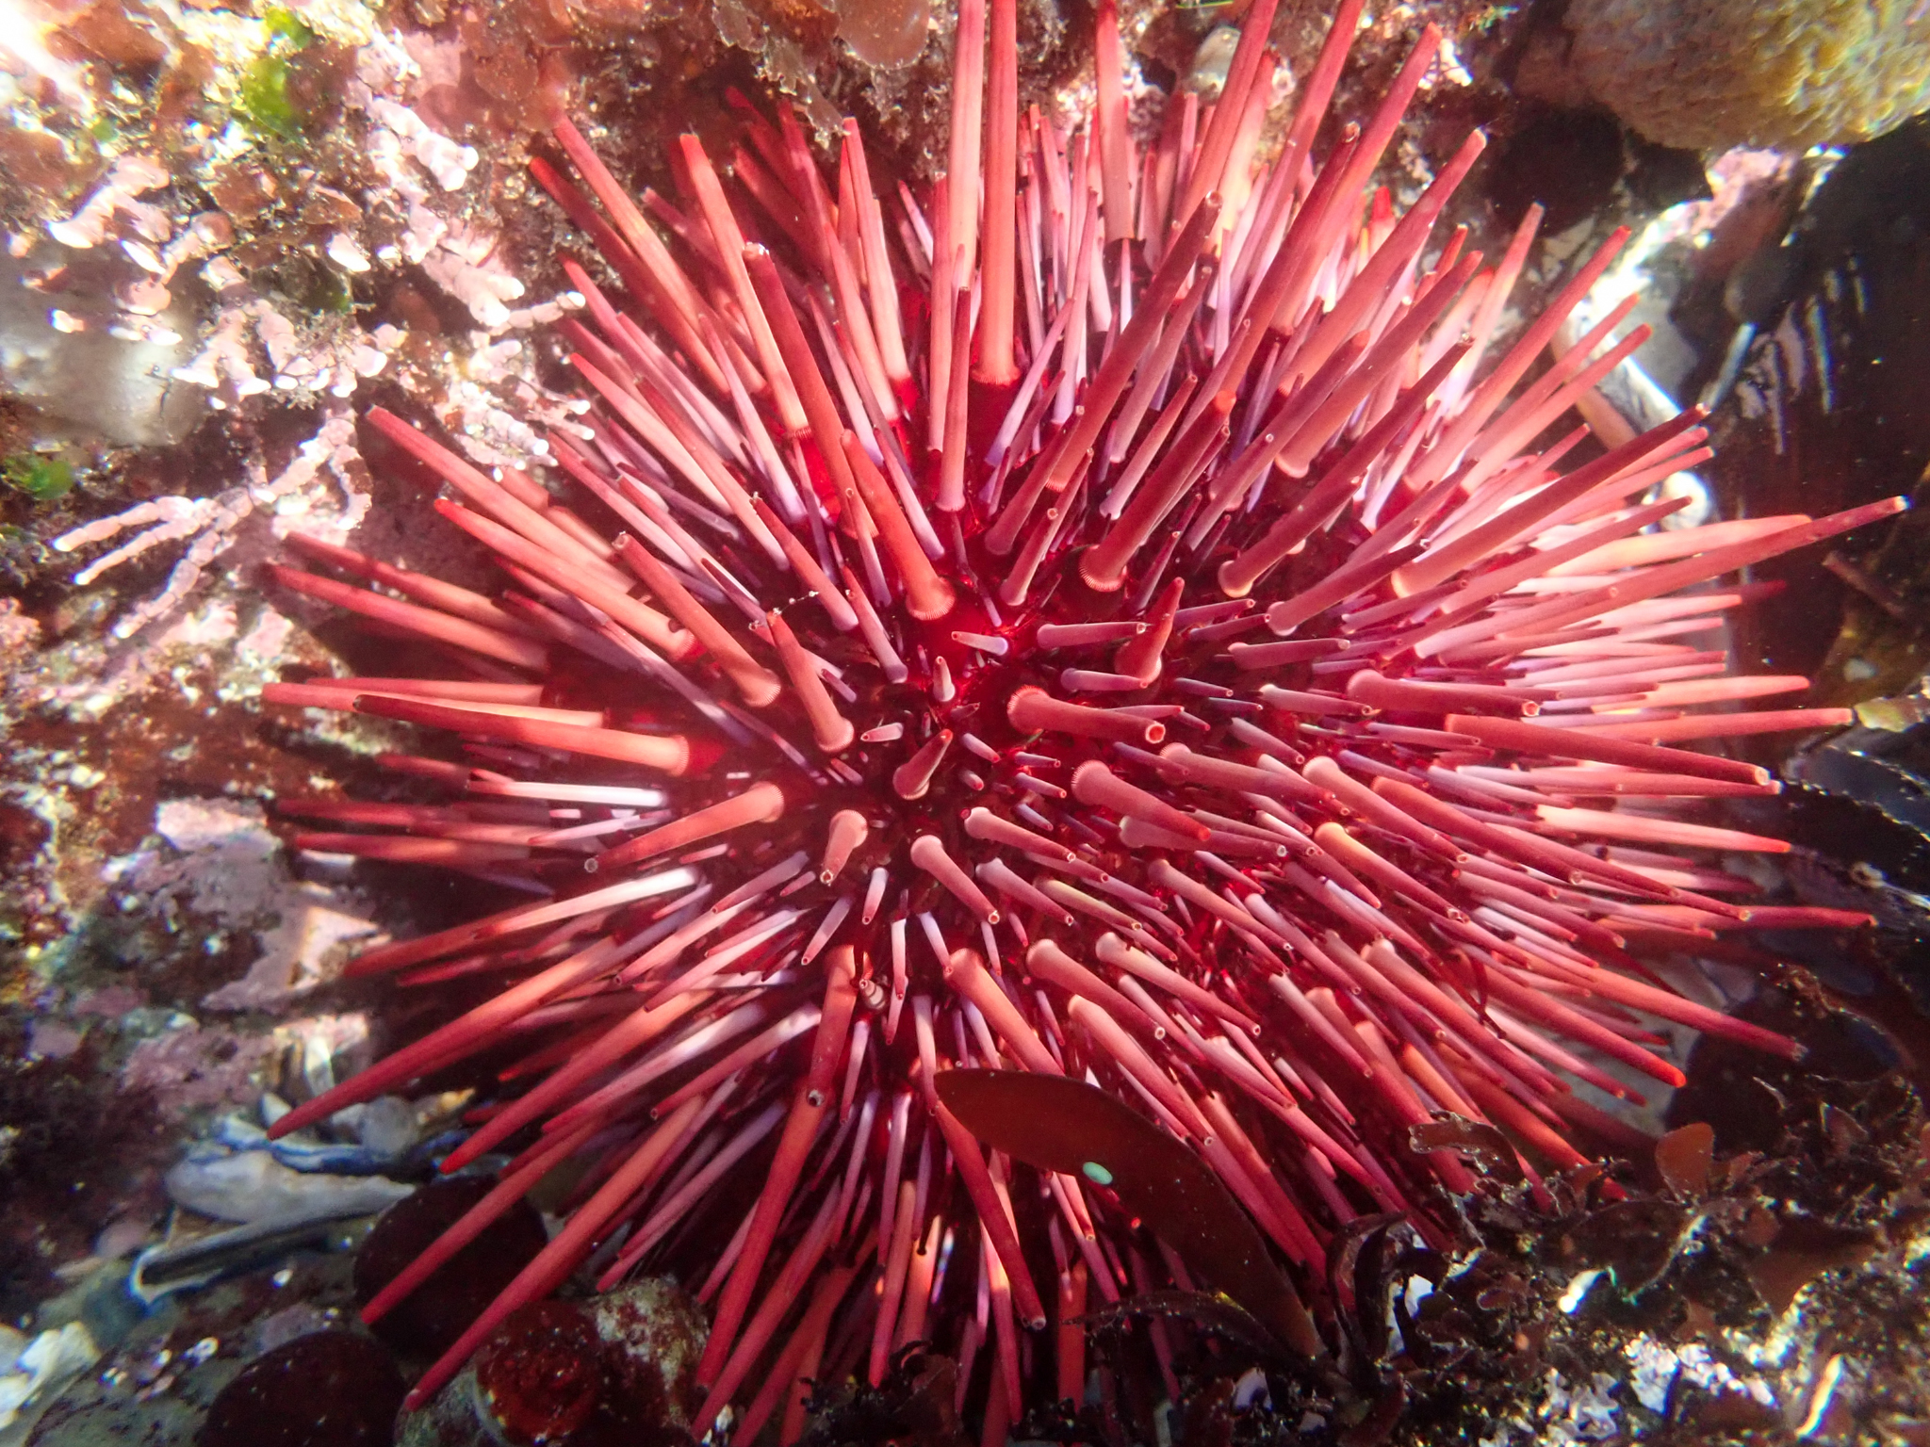
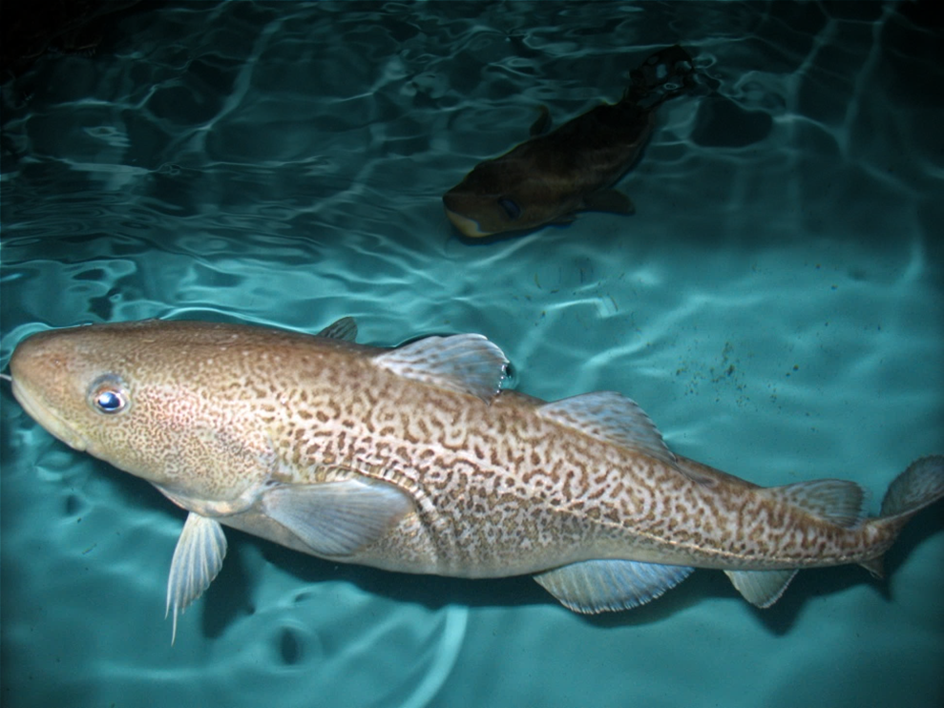
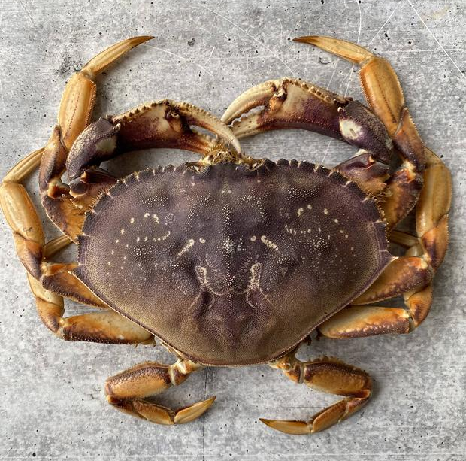
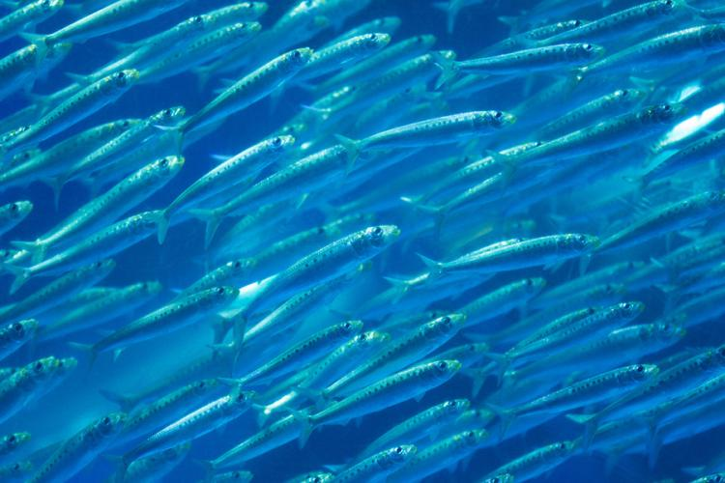
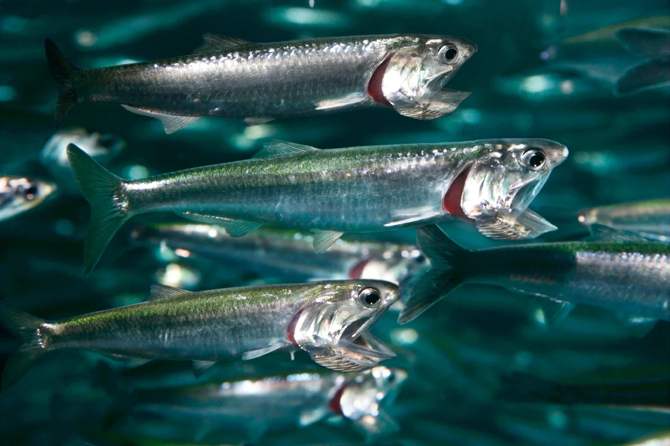
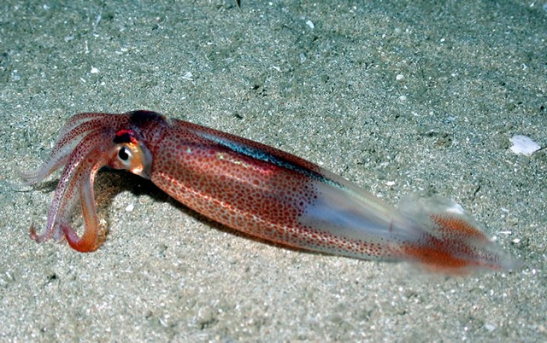
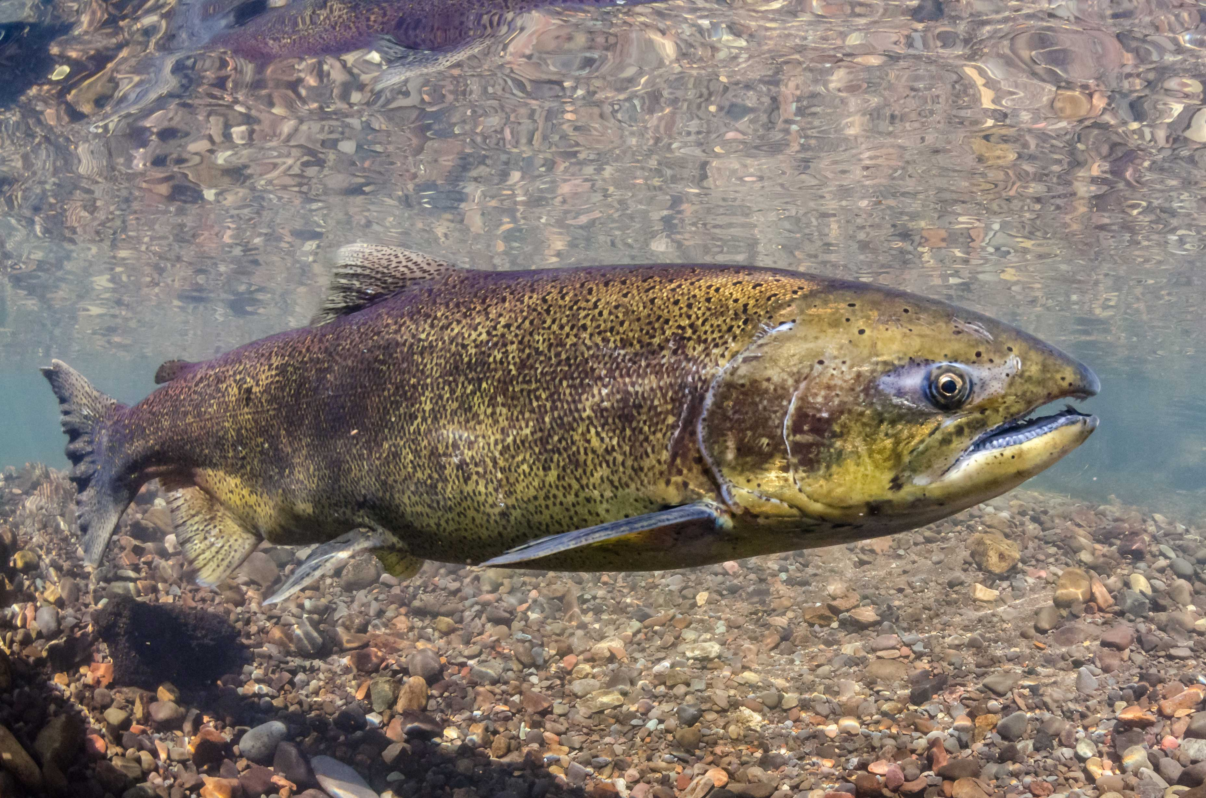
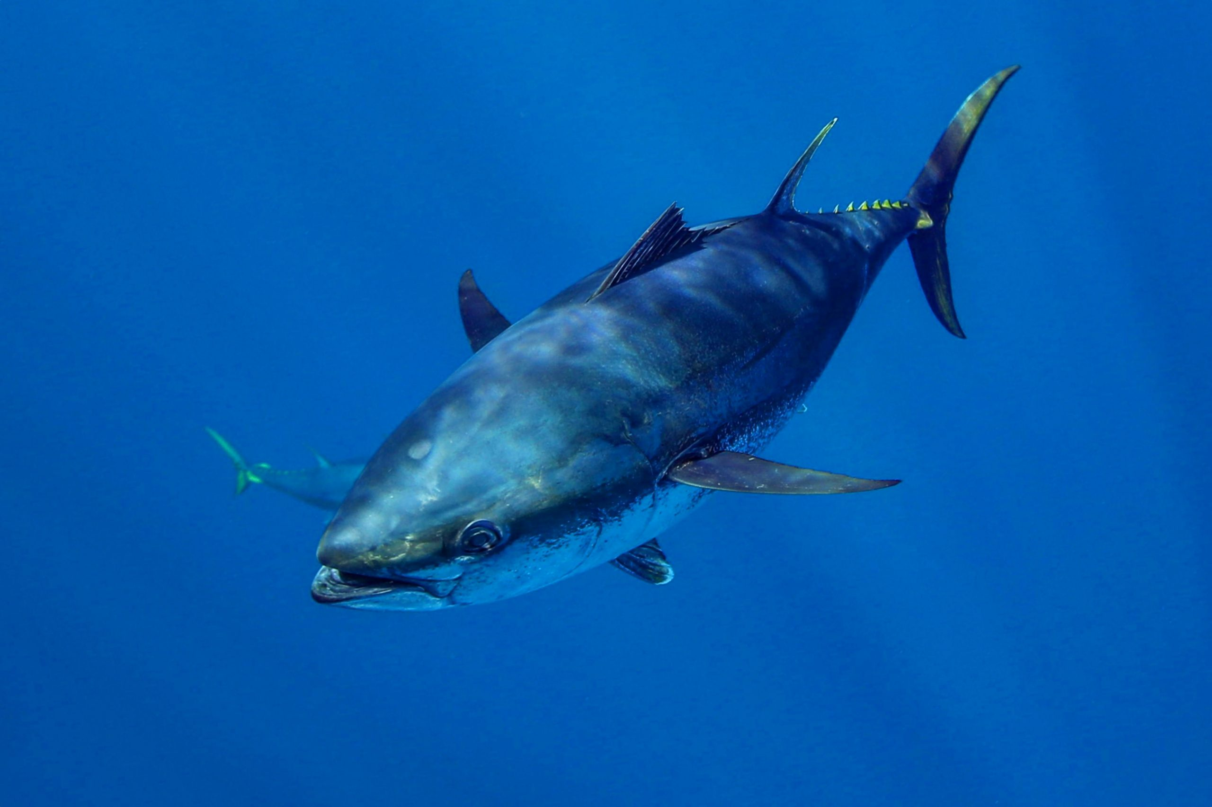
Urchin/abalone
Population declines due to loss of kelp beds.
Bocaccio
Enormously high recruitment rebuilds threatened fish stock.
Pacific cod
Population declines due to reduced prey and increased metabolic demands.
Shrimp
Major heatwave and climate change winner – but don’t know why yet
Dungeness crab
Fishery closures due HABs and whale entanglements.
Shortbelly rockfish
Increases in abundance approached bycatch limits in Pacific hake fishery.
Sardine/anchovy
Sardines low while anchovies high; surprise!
Market squid
Increases in distribution leads to unregulated emerging fishery.
Chinook salmon
Overfished due to reduced productivity and model failure.
Bluefin tuna
Increased abundance was a boon for the recreational fishing industry.
Direct negative impacts
Indirect negative impacts
Neutral
impacts
Positive impacts, w/ higher mgmt. challenges
Positive impacts, w/ lower mgmt. challenges
Ecological impact of the heatwave

